Slide 1
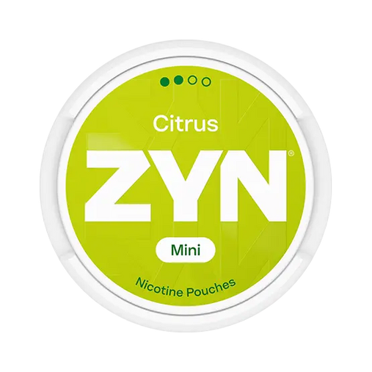
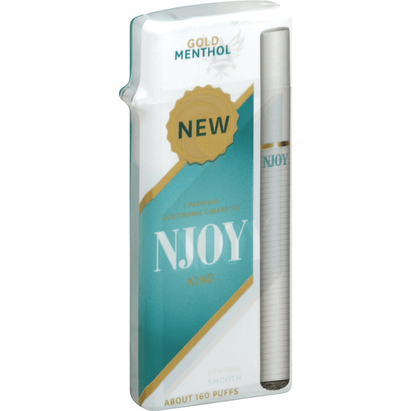
Electronic Cigarettes and Oral Nicotine Pouches
New Enforcement Information from the FDA
January 6, 2026

Slide 2
Disclaimer
This information is provided for educational purposes only and is not to be construed as legal advice.
For legal advice, please contact your municipal attorney.

Slide 3
What are these products and why do we care?

Slide 4

How to Use a Nicotine Pouch:
“discreet and convenient design”

Slide 5
How Popular Are They?
From 2016 to 2023 sales increased from 6 million to 334 million. (CDC)
From 2019 to 2023 current use among MA high students tripled. (1% to 3.2%) (2023 MA YHS Tobacco/Nicotine Use)
Can be used discreetly in school.
No smoke or vapor.
Small.
Containers look like they contain mints or gum.
Can be used anywhere.
2nd most popular tobacco/nicotine product used by youth in 2024. (NYTS 2024 data)
480,000 middle and high school students using nationwide. (NYTS 2024 data)
The only commercial nicotine product in MA not subject to any excise tax.

Slide 6
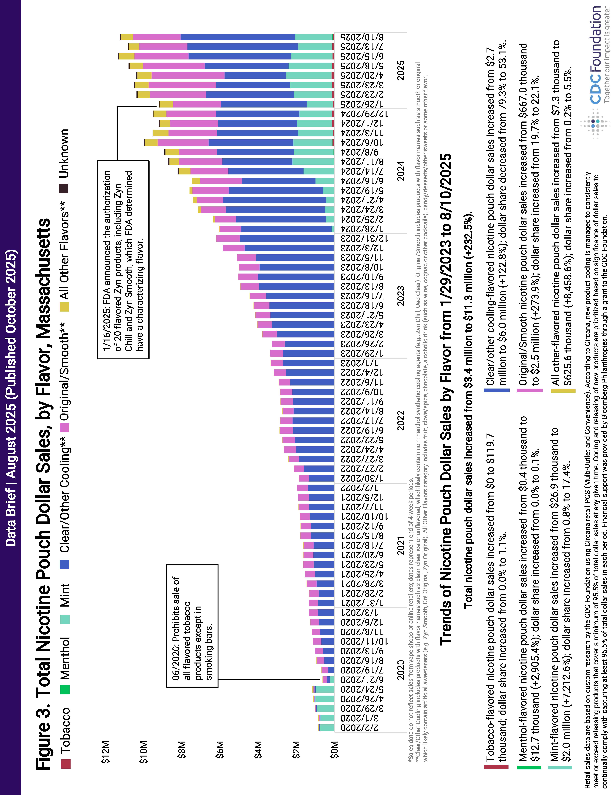
Vast Majority are flavored

Slide 7
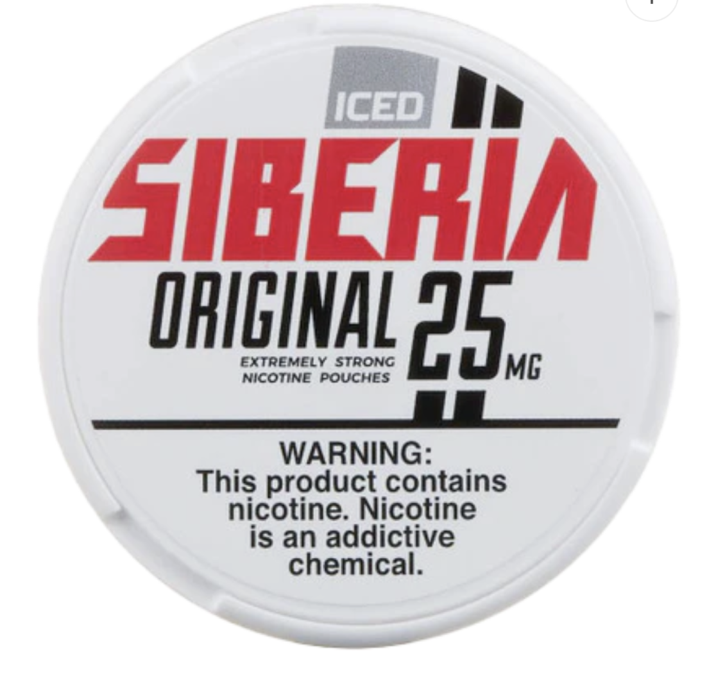
Nicotine Strength Varies
Low strength: 2 - 4 mg.
  For beginners.
  Marketed as “particularly beneficial for those who are experimenting with nicotine for the first time.”
  https://alppouch.com/
Medium strength: 6 – 8 mg.
  For those with moderate nicotine tolerance.
High Strength: 10 – 14 mg.
  For those with high nicotine tolerance providing a “robust experience.”
Extra High Strength: 16 – 20 mg.
  For those with very high nicotine tolerance.
Loon NYXX – Bad Bull: 28 mg.
  Some higher.

Slide 8
Health concerns – oral nicotine pouches
Youth use of nicotine in any form is unsafe.
  Interferes with brain development, mental health, and long-term addiction risk. (CDC)
Irritates digestive tract lining, and can contribute to acid reflux, gastritis, peptic ulcers. (https://healthline.com/health/nicotine-pouches?utm_)
Evidence of significant impact on oral mucosa with white lesions that revealed important changes at the cellular level. (https://link.springer.com/article/10.1186/s13000-024-01549-3?utm_)
Associated with increase mortality risk in those with pre-existing ischemic heart or cerebrovascular disease. (https://pubmed.ncbi.nlm.nih.gov/39624904/)
Current evidence does not support meaningful performance-enhancing effects of nicotine use in athletics. Reviews generally find minimal or no ergogenic benefit. (https://pmc.ncbi.nlm.nih.gov/articles/PMC5684328/?utm_)
High nicotine levels and inaccurate labeling of actual amount of nicotine – can result in nicotine poisoning. (https://pubmed.ncbi.nlm.nigh.gov/38378209)

Slide 9
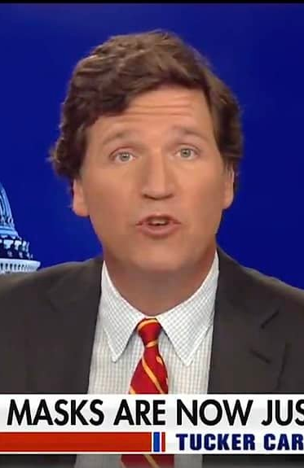
Marketing Strategies
It’s a harm reduction product.
  No evidence that it helps quit smoking/vaping.
  Not an FDA approved cessation device.
  FDA authorized 3 mg. and 6 mg. Zyn products with explicit statement that:
  “The authorization does not allow the company to make reduced risk claims about the products.”
Zynfluencers
  Tucker Carlson
  “Then you feel the power rising from your central nervous system, then going outward through all the nerve endings down to the tips of your fingers. And then up here, it just starts crackling the synapses.”
  “Zyn is a lifesaving medical product that enhances male vitality and mental acuity.”
This Photo by Unknown Author is licensed under CC BY

Slide 10
Is Zyn the New Juul?
A Cautionary Tale
Philip Morris International (MPI) bought Swedish Match for $16 billion in 2022.
PMI sales are at record highs.
Sales fueled by sale of Zyn.
In 2024 shipments of Zyn rose 644 million cans, up by more than half from 2023.
PMI cannot keep up with the demand.
Expanding a factory in Kentucky.
Building a new factory in Colorado for $600 million.
PMI pledged to make two-thirds of its income from products like Zyn by 2030.
ALTRIA bought Juul for $12.8 million.
  Within 4 years it was nearly bankrupt by lawsuits blaming it for targeting youth.
  Or is this wishful thinking?

Slide 11
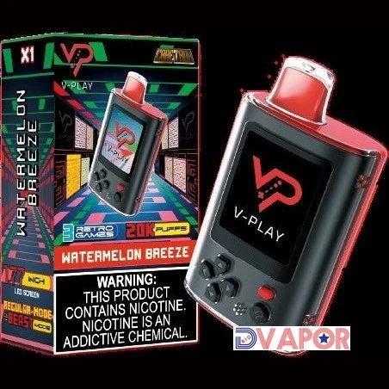
Vaping basics
November 2019 – Governor Baker declared public health emergency and ordered a 4-month ban of e-cigarettes.
  200 reported cases
  82% required hospitalization
  Of confirmed cases
    30% vaped only nicotine
    39% vaped only THC
    25% vaped nicotine and THC
Currently, more than 1.6 million kids use e-cigarettes
  42% of high school users report frequent or daily use.
    Most popular tobacco/nicotine product used by youth in 2024.
  Nicotine levels have skyrocketed.
    As much nicotine as in 20 packs of cigarettes
    Products designed as video games, guns, etc.
      CTFK, 2024 National Youth Tobacco Survey

Slide 12
Health concerns – Vaping Products
Youth use of nicotine in any form is unsafe.
  Interferes with brain development, mental health, and long-term addiction risk. (CDC)
Heats small particles of nicotine, metal and other substances. Not WATER VAPOR. (https://www.ncbi.nlm.nig.gov/books/NBK507163/?utm_)
Produces chemicals which can cause lung and heart disease, including formaldehyde and acrolein. (https://www.cdc.gov/tobacco/e-cigarettes/health-effects.html)
High nicotine levels and inaccurate labeling of actual amount of nicotine – can result in nicotine poisoning. (https://pubmed.ncbi.nlm.nigh.gov/38378209)
Ultrafine particles are inhaled deep into lungs, sometimes resulting in EVALI, using either nicotine or THC. (CDC)
Secondhand emissions contain nicotine, ultrafine particles, diacetyl, which is linked to lung disease, and benzene and heavy metals, found in car exhaust. (https://www.heart.org/en/news/2022/05/31/in-secondhand-vape-scientists-smell-risk?utm_)

Slide 13
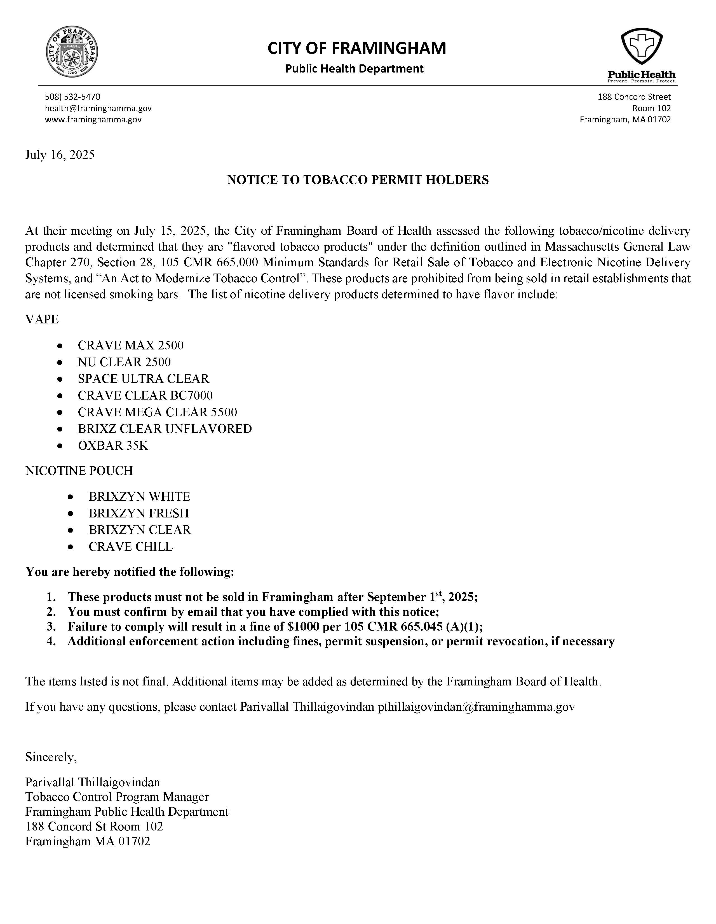

Where does that leave health inspectors?
“New” flavored products found every day in stores sniff/taste test but, Not authorized by FDA

Slide 14
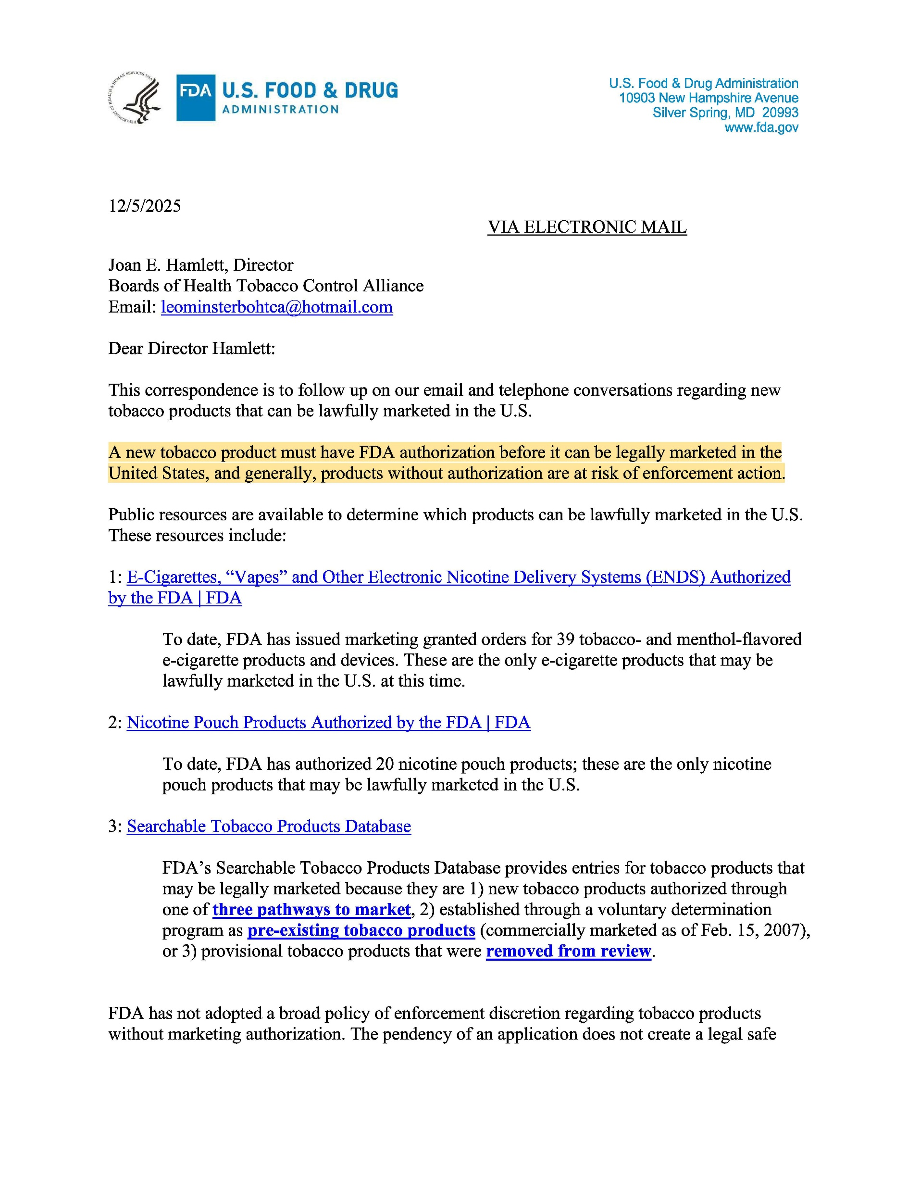
Letter from u.s. food & drug administration dated 12/5/2025

Slide 15
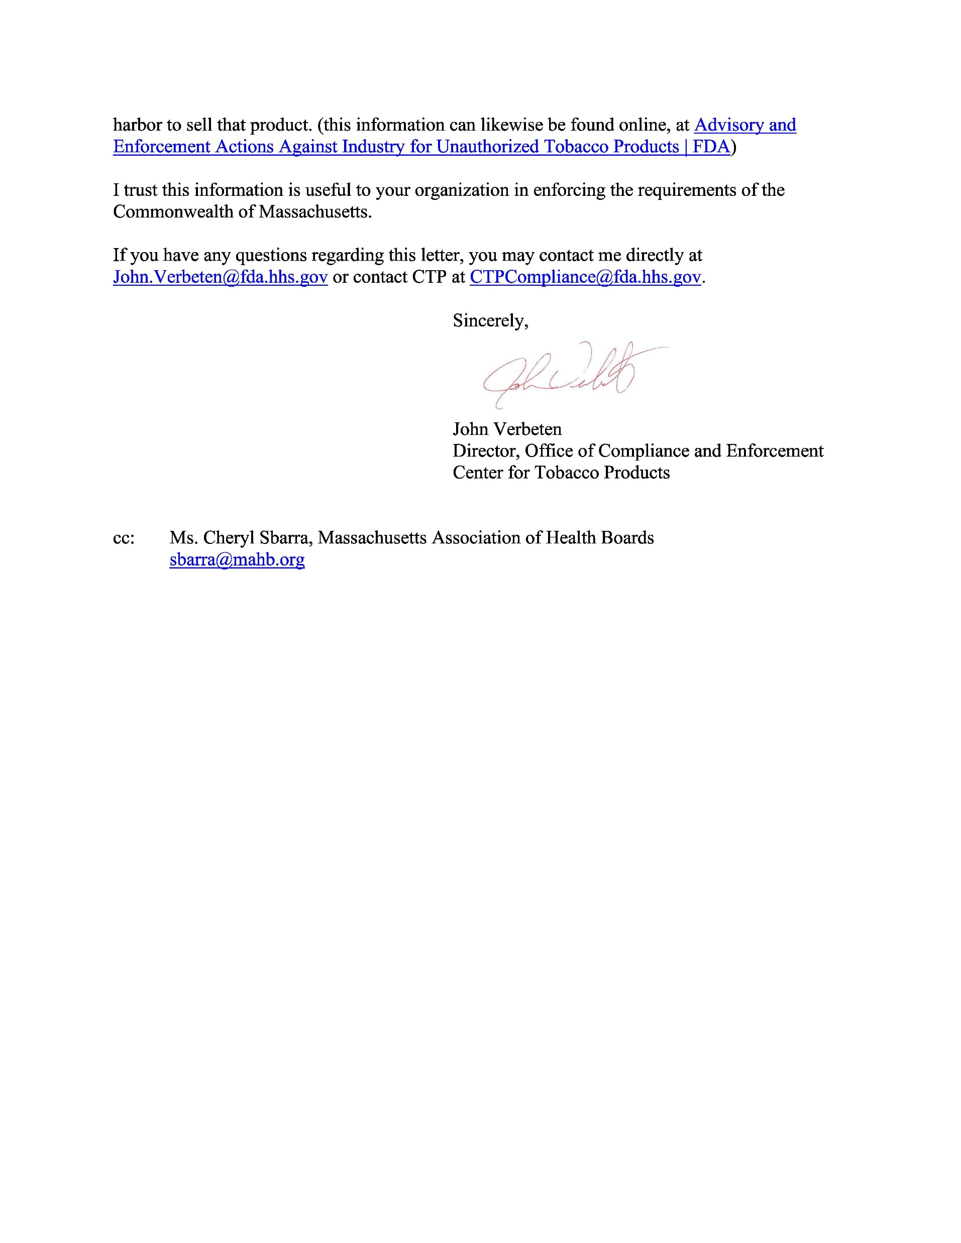

Slide 16
Highlights from letter
“A new tobacco product must have FDA authorization before it can be legally marketed in the United States . . .”
Only products with Marketing Granted Orders can be sold in the United States.
“Public resources are available to determine which products can be lawfully marketed in the U.S.”
“The pendency of an application does not create a legal safe harbor to sell that product.”
“I trust this information is useful to your organization in enforcing the requirements of the Commonwealth of Massachusetts.”
Signed by John Verbeten, Director, Office of Compliance and Enforcement, Center for Tobacco Products as the FDA.
Directed to Joan Hamlett, Director, Boards of Health Tobacco Control Alliance.
Cc” Cheryl Sbarra, Massachusetts Association of Health Boards

Slide 17
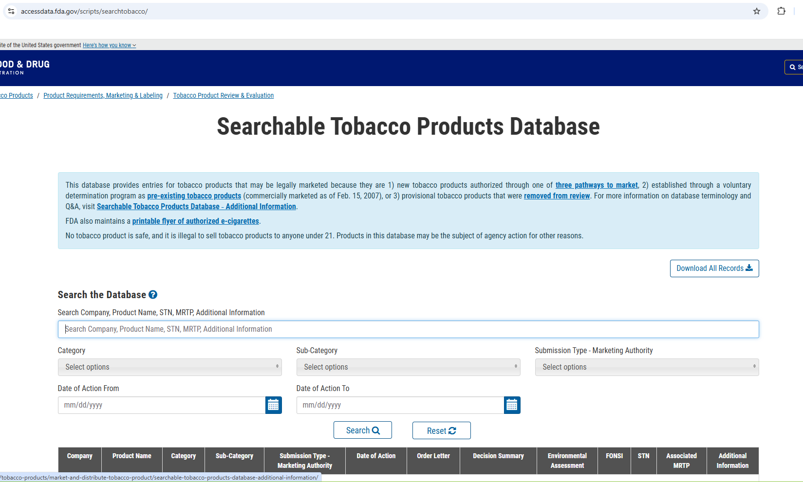

Slide 18
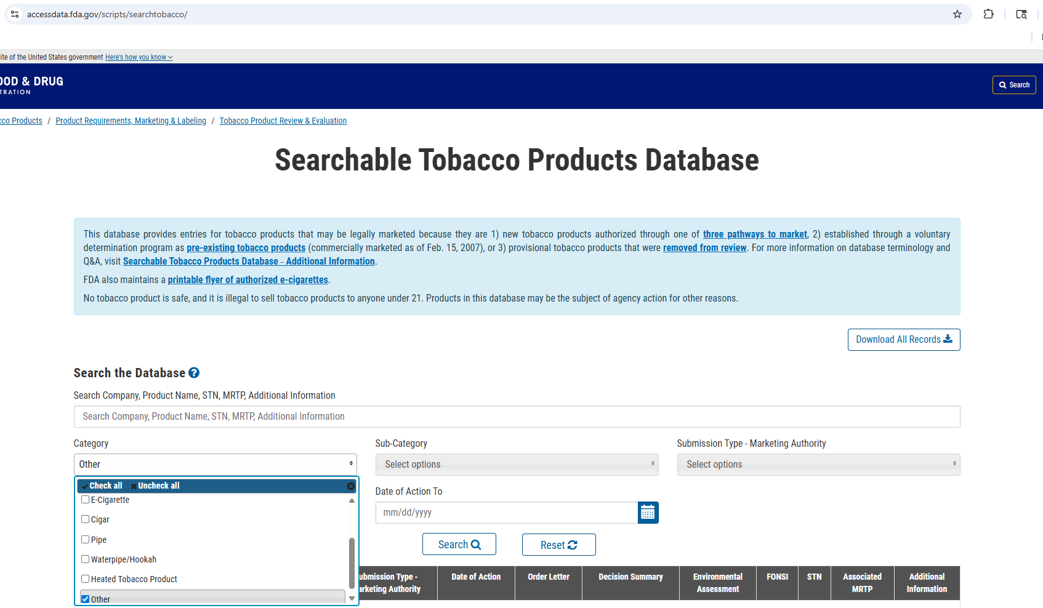

Slide 19
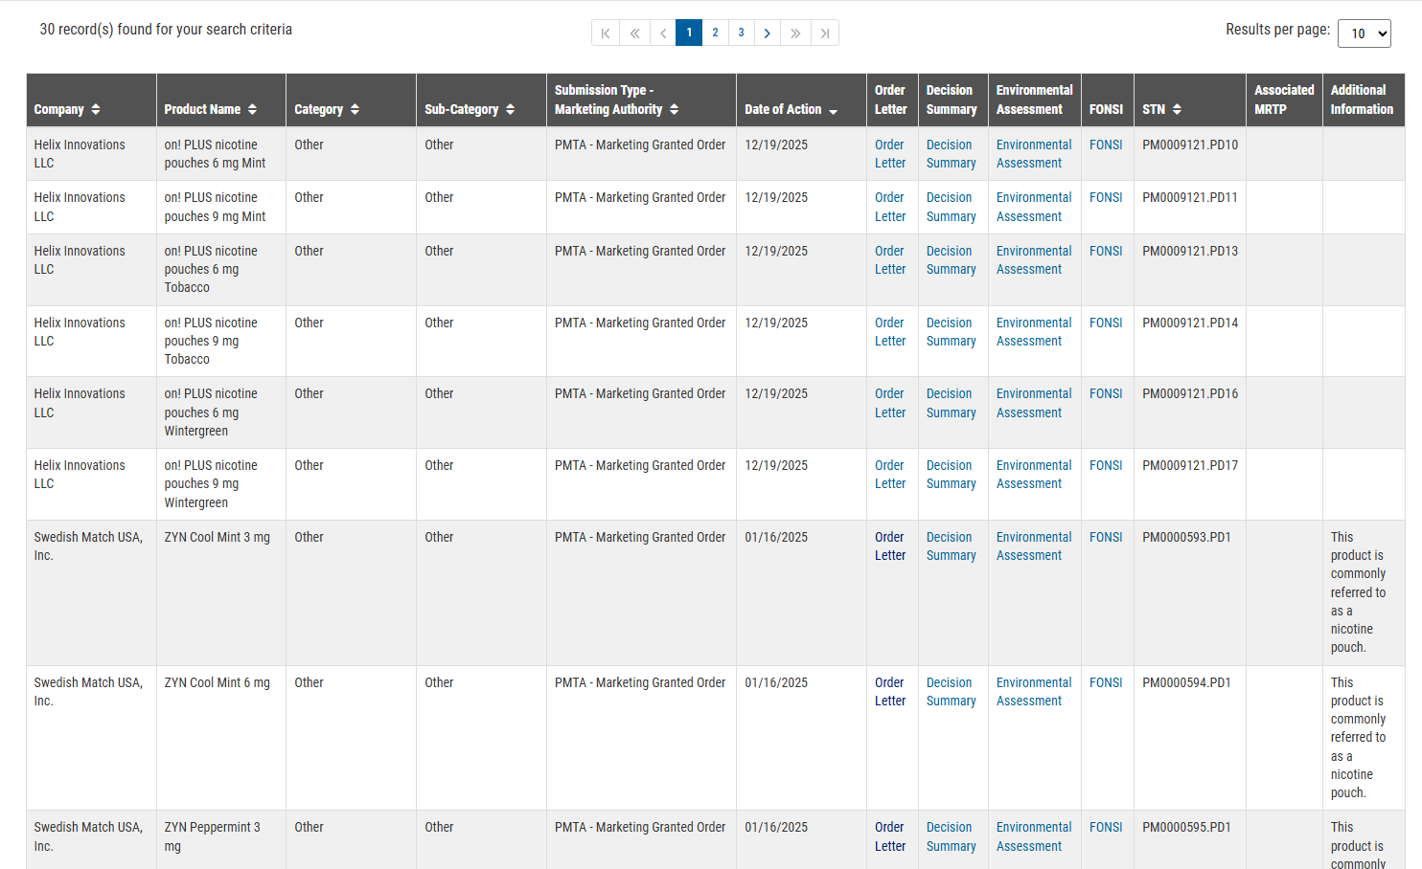

Slide 20
Products with marketing granted Orders as of 12/19/2025
39 vapes:
  Vuse
  Juul
  NJOY
  Logic
Some are just the tanks and accessories.
At least 6 are flavored and cannot be sold in MA
30 pouches:
  on!
  VERVE
  ZYN
2 of them are labeled “tobacco” flavored. (on!)

Slide 21
Enforcement strategy moving forward
MA local tobacco sales regulations require applicants to sign a statement affirming their responsibility to comply with all federal, state and local laws.
Marketing Granted Orders are one such federal requirement.
FDA currently mandates that only products with Marketing Granted Orders may be sold in the U.S.
We are not enforcing the FDA mandate, but rather we are enforcing one part of the local regulation that says applicants must comply with all federal, state and local requirements.
Remember that MA local tobacco sales regulations are more comprehensive than FDA requirements. For example, MA prohibits flavored nicotine products.
Review this with your municipal attorney! Vapor Tech. Ass’n v. Wooten Docket No. 25CV00076-M-RJ, (E.D. NC 6/27/15 7/3/25)

Slide 22
Next steps
Template Guidance Document to share with Health Departments, Tobacco Control Collaboratives, municipal attorneys.
  Suggested protocol
  Notice to retailers
    Written template drafted
  Educational visits
  Request removal of products without Marketing Granted Orders
  Document products without Marketing Granted Orders if not removed at next visit
  Report products without orders to the FDA illegal tobacco products portal
  Report findings to board of health

Slide 23
Questions and contact information
Cheryl Sbarra, Esq., Executive Director and Senior Staff Attorney, Massachusetts Association of Health Boards, sbarra@mahb.org
Christopher Banthin, Esq., Program Manager, Public Health Advocacy Institute, chrisbanthin@phaionline.org
Lisa Stevens-Goodnight, Esq., Tobacco Control Director, Massachusetts Municipal Association, lstevensgoodnight@mma.org
Sarah McColgan, Tobacco Control Director, Massachusetts Health Officers Association, smccolgan@mhoa.com

