Slide 1

Nicotine-Free Generation Overview
Amy Luckiewicz, DFC Project Director

Slide 2
Focus on Primary Prevention
PRIMARY prevention is action that tries to stop diseases from ever starting. Example: immunizations
SECONDARY prevention is action which focuses on early detection of a disease.
Example: Early Intervention and some screenings
TERTIARY prevention prevention focused on interventions to SLOW or STOP the disease.
Example: medicine, tumor removal surgery, masks, substance use treatment

Slide 3
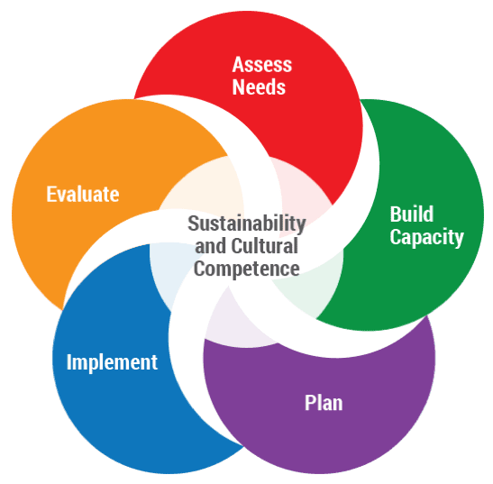
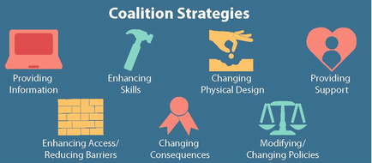
Coalition’s Charge
To utilize science-based PRIMARY prevention strategies to reduce or eliminate youth substance use.
7 Strategies for Community Change
Strategic Prevention Framework

Slide 4
NFG Overview
Smoking is
NOT a fundamental
right.
Nicotine-Free Generation (sometimes called Tobacco Free Generation) is a policy that is implemented at the local level to limit the sale of nicotine products over time.
It ties the ability to buy nicotine products to a set date versus
a person’s birthdate. It does NOT take away anyone’s ability
to purchase nicotine IF THEY ALREADY HAVE THE RIGHT.
It incrementally phases out nicotine sales, allowing
retailers to adjust their business models over years.
NFG will NOT prevent internet sales, however, it will
reduce the likelihood of use by reducing access to products at an enforceable local level.
It’s ultimate goal is to prevent nicotine addiction using a primary prevention model.
Example policy
Policy effect date: 1/1/2025
Birthdate restriction: 1/1/2004 (21 years before the effective date)

Slide 5
History
Originally proposed in Singapore, Brookline was the first municipality to pass the policy in Massachusetts in 2020.
Brookline’s actions were challenged in the State Judicial Court. The action was upheld in March, 2024 (9-0) as lawful.
Since Brookline’s action, many other MA communities have taken action to pursue NFG, most have active Coalitions with many others preparing to take action.
We have other examples of product bans focused on community health that include lead-based paint and asbestos.
In June, 2024, the North Reading Coalition unanimously voted to advocate for NFG.

Slide 6
Why NFG
Smoking is still the leading cause of preventable death – almost a half a
million Americans die from preventable smoking related illnesses every year.
More than 80% of smokers start by age 18, and virtually all by 26.
The tobacco industry has been shown in court to utilize a marketing play book and produce products to entice young people to use and perhaps become lifelong customers.
New products, like salt nicotine and nicotine pouches create a “more comfortable” way to consume high-nicotine products.

Slide 7
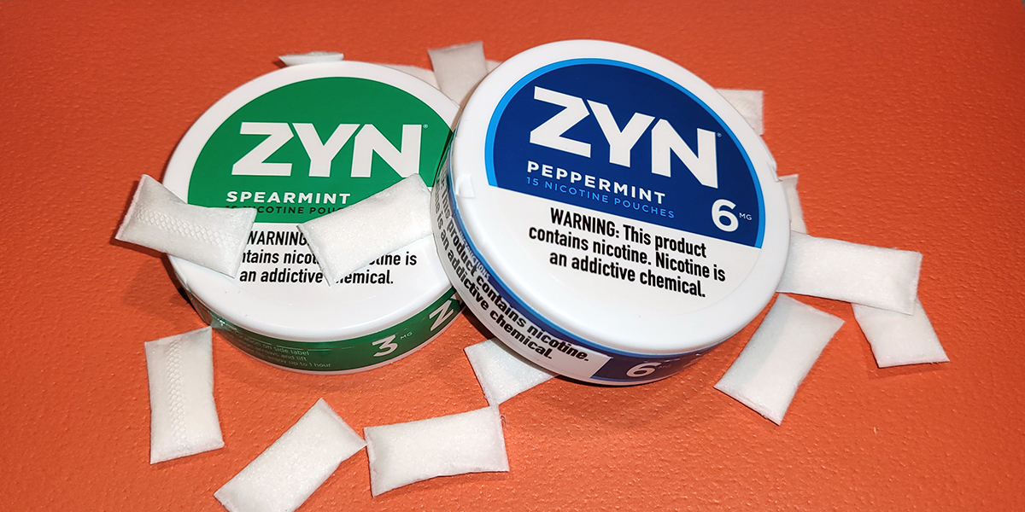
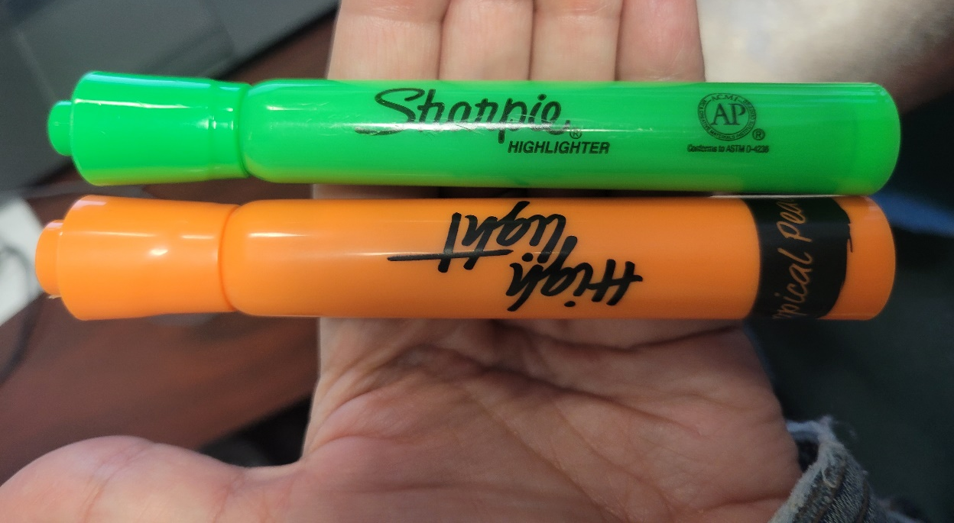
Why NFG: New Product Examples
Salt nicotine discreet pouches like Zyn represent a change in form of nicotine consumption. Nicotine is absorbed through the mouth and do NOT cause saliva discharge like traditional “chew.”
Online sales of flavored and mimic products
continue to attract youth. NFG will not likely affect these sales directly, but rather reduce the demand for products among youth.

Slide 8
Why NFG: North Reading Data (April, 2025)
Past 30-day Use | 6th | 7th | 8th | 9th | 10th | 11th | 12th
Any tobacco | 3.41% | 0.78% | 1.15% | 4.23% | 1.83% | 7.00% | 18.02%
Any vape | 3.41% | 0.78% | 4.60% | 4.23% | 1.82% | 6.86% | 18.02%
Any nicotine pouch | 0.0% | 0.0% | 1.2% | 0.7% | 0.0% | 1.9% | 8.3%
Source: April, 2024 North Reading Core Measurement Survey
Source: National Institute on Drug Abuse “Monitoring the Future Study” University of Michigan, 2023

Slide 9
Why NFG
North Reading students in grades 6-12 self-identified the median age of first use of vape products at age 17 and the first use of tobacco products at age 16.
Although data show that the rate is declining (over 2023), in many categories,
North Reading uses MORE nicotine products than the national average.
It is a complimentary action to the BOH’s efforts to reduce outlet density (July, 2024).
It includes ALL nicotine delivery products, staying ahead of any “future” product that may come on the market.
NFG is primary prevention. The Coalition’s main goal is to prevent substance use BEFORE it starts.
Source: April, 2024 North Reading Core Measurement Survey
Source: National Institute on Drug Abuse “Monitoring the Future Study” University of Michigan, 2023

Slide 10
The Coalition’s NFG Vision
The vision is that in a generation, young people will think it strange to see someone using a nicotine product, just as most of today’s young people have never been in a restaurant, theater, school, or hospital with a smoking section.
The North Reading’s Board of Health
Areas which fall under the purview of the Town Board Health include disease and injury prevention, promoting and offering immunization clinics, responding to bacterial illnesses, monitoring disease outbreaks, providing health education & prevention programs, provide health advisories, promoting health & wellness, nutrition and fitness information, tobacco control programs, environmental protection, respond to health hazards, ensuring water quality, monitoring waste disposal, investigating noise & air pollution, animal health, health monitoring, enforcement and ensuring of health and safety codes, health care access, and emergency preparedness and response.

Slide 11
Recommended Viewing
Tobacco Free Generation: Brookline’s Model for Ending Tobacco in the US (YouTube)
https://www.youtube.com/watch?v=6wrV_H5ct78&t=2s
Need Help Quitting?
Contact Laura Miranda at 978-357-5038 or lmiranda@nrpd.org

